Slide 1
Solar Power Suitable Lands in Palm Beach County, Florida
By: Max Grossman
GEOG6293

Slide 2
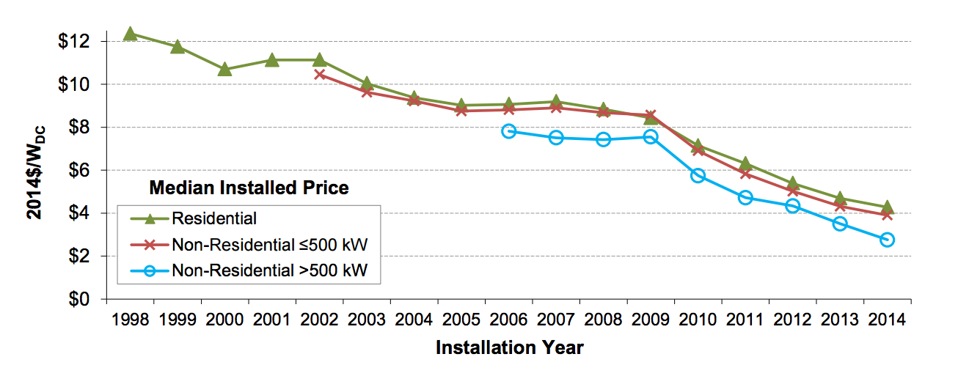

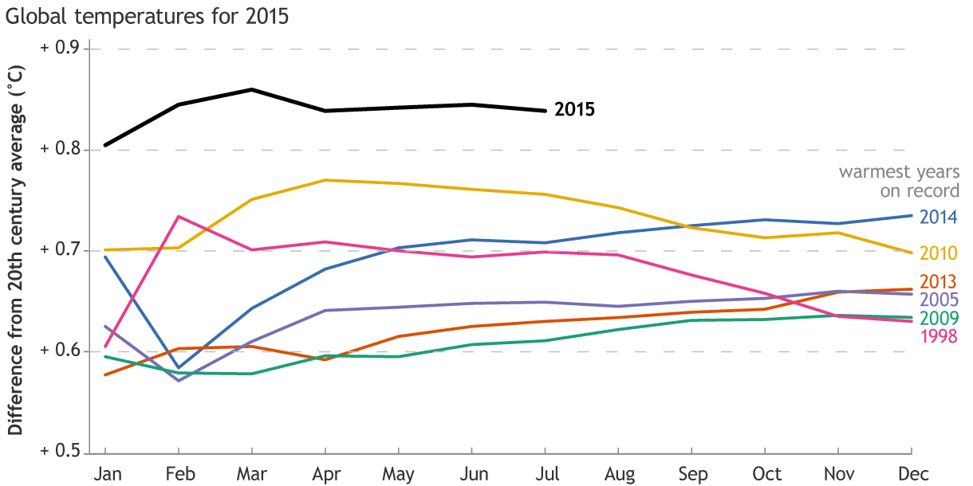
Solar in Florida: Why does it matter?
3rd highest rooftop solar potential in U.S – cleantechnia.com
13th in Nation for installed capacity (234 megawatts) -cleantechnia.com
But why Palm Beach?
Source: Lawrence Berkeley National Lab
Source: NOAA

Slide 3
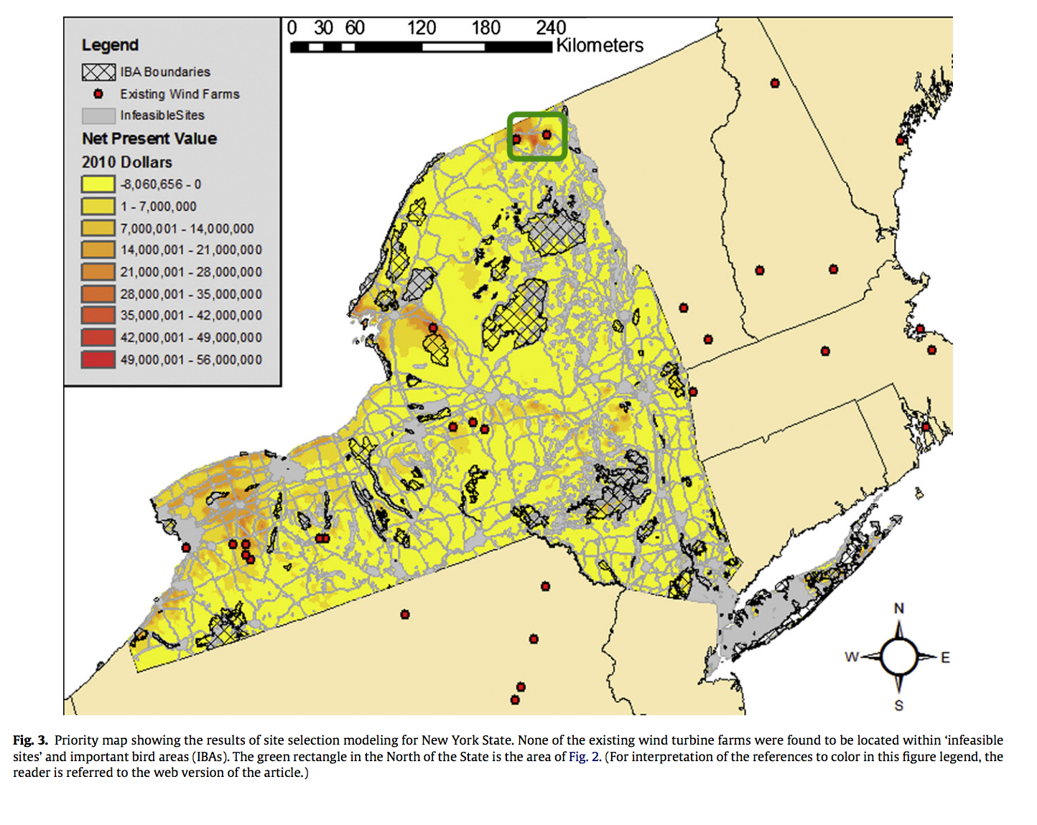
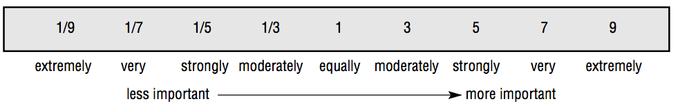
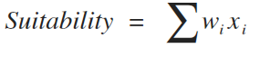
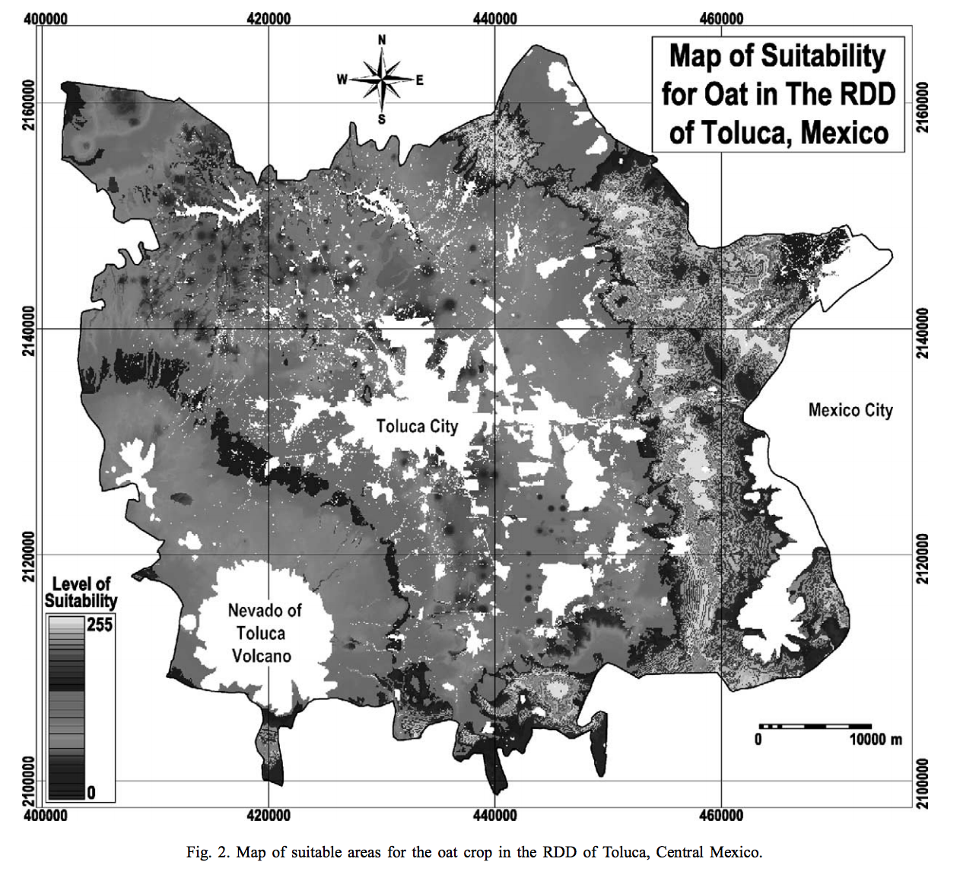
Multicriteria evaluation: how it can help you.
A robust spatial analysis tool
Basics
Source: J R Eastman
Source: van Haare, Fthenakis
Solar Suitability Criteria
Criteria | Values | MCE Weight
Solar Potential | GHI | 3
Inverse Distance to Powerline | Meters | 2
Distance to city | Meters | 1
Population Density | People/KM | 1
Inverse Distance to Road | Meters | 1
Landcover | Categorical | 1
Fed Land | Categorical | 1
Source: Ceballos-Silva, Lopez-Blanco

Slide 4
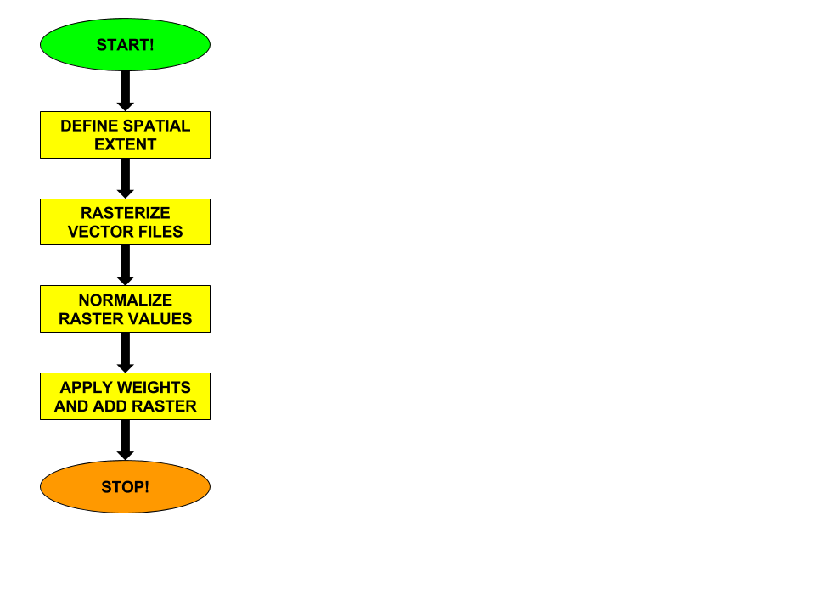
Tricky Task 1: Fishnets.
Sneaky solution: for loops, dictionaries, lists
# First I set the three fc I want to calculate distance from to variables
Cities = "WP_Cities"
Roads = "WP_Roads"
Powerlines = "WP_Powerlines"
FedLands = "clipped_WP_fedland_Albers_Straight"
# I then add these to a dictionary with these variables as the keys and
WPdict = {}
WPdict [Cities] = "Cit"
WPdict [Roads] = "Rds"
WPdict [Powerlines] = "Pwr"
WPdict [FedLands] = "Fed"
addedfields = []
# I set "WestPalmFishNet" to a variable used in for loop
shp = "WestPalmFishNet"
for NearFC in [Cities, Roads, Powerlines, FedLands]:
# Perform Near Analysis
arcpy.Near_analysis(shp, NearFC)
# Add fields that will store these results
arcpy.AddField_management(shp, WPdict[NearFC] + "_DIST", "DOUBLE")
# Store the Analysis information in these fields
arcpy.CalculateField_management(shp, WPdict[NearFC] + "_DIST", "!NEAR_DIST!", "PYTHON_9.3")
# Next I will delete the original Near_FID and Near_DIST fields
# I do not need them as I copied their information to new fields
arcpy.DeleteField_management(NearFC, "NEAR_DIST”)
# Lastly, Track the added fields and print it to verify
addedfields.append(WPdict[NearFC], + "_DIST")
print addedfields

Slide 5
Tricky Task 2: Normalize? Inverse Distance?
Sneaky Solution: expressions, codeblocks
Limited, I think.
# Before I calculate the fields, I need to add them. I use Addfield_management
arcpy.Addfield_management("WestPalmFishNet", "NormDistRoad", 'FLOAT')
# Next I use CalculateField_management to normalize
# This is the in table
inTab = "WestPalmFishNet”
# this is the expression to calculate the field
expression_rds = "Normalizer(float(!Rds_DIST!))”
# This is the codeblock defining Normalizer():
codeblock_rds = """def Normalizer(Rds_DIST):
rds = Rds_DIST
rdsMin = float(0)
rdsRng = float(29879.68916)
rds_transform = rds - rdsMin
rds_norm = rds_transform / rdsRng
return rds_norm"""
# Running Calculate Field
arcpy.CalculateField_management(inTab, "NormDistRoad", expression_rds, "PYTHON_9.3", codeblock_rds)
# Adding the new field for Inverse
arcpy.Addfield_management("WestPalmFishNet", "RoadsInvDis", 'FLOAT')
# the expression used to calculate the new field
expression_InvRds = "FlipValue(float(!NormDistRoad!))”
codeblock_InvRds = """def FlipValue(NormDistRoad):
InvDist = NormDistRoad
dist_to_min = InvDist - float(0)
dist_to_max = float(1) - InvDist
if dist_to_min < dist_to_max:
InvDist = float(1) - dist_to_min
if dist_to_min > dist_to_max:
InvDist = 0 + dist_to_max
else:
InvDist = InvDist
return InvDist """
arcpy.CalculateField_management(inTab, "RoadsInvDis", expression_InvRds, "PYTHON_9.3", codeblock_InvRds)

Slide 6
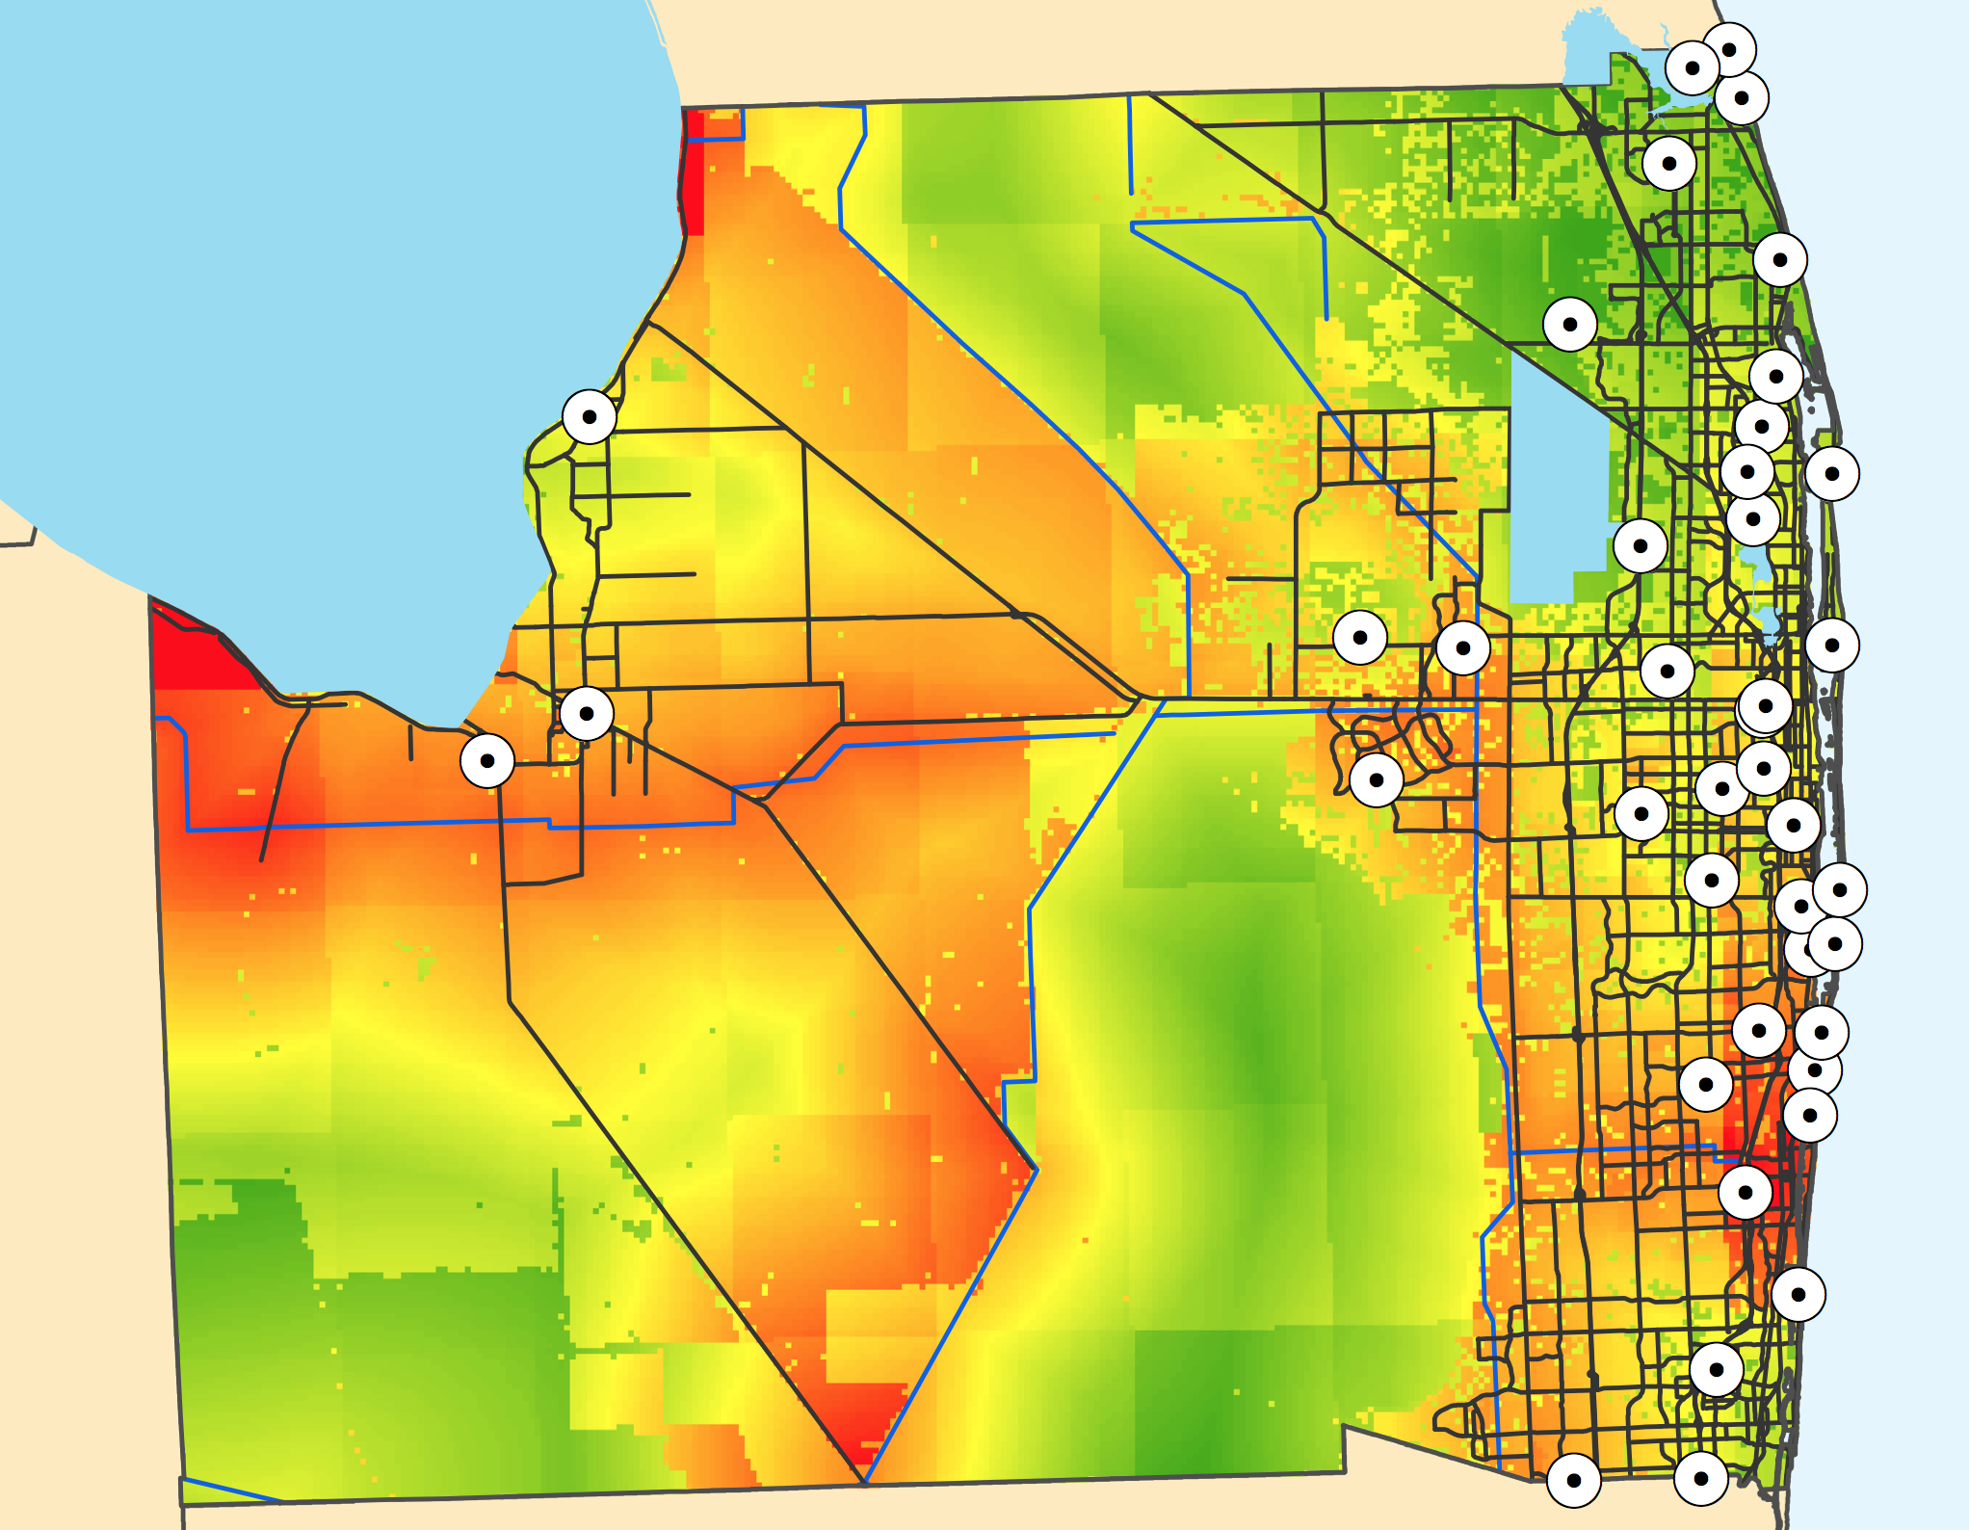
Conclusion: Starting point?
Conclusions: Starting Point?
Solar Lessons
The criteria I used seems somewhat nebulous
Financial Modeling & Energy Demand are absent
MCE might be obsolete for residential solar
Geostellar
Utility scale database?
Geoprocessing/Coding Lessons
If you can go polygon to raster, go polygon to raster
Easier and more certain.
But, depending on spatial resolution requirements, can be very slow
Test complex for loops on small datasets first before large ones

